Slide 1

Hard way to apply digital process twins
Prepared by:
Dávid Havas
CDAO Benelux
Amsterdam
12.11.2025

Slide 2
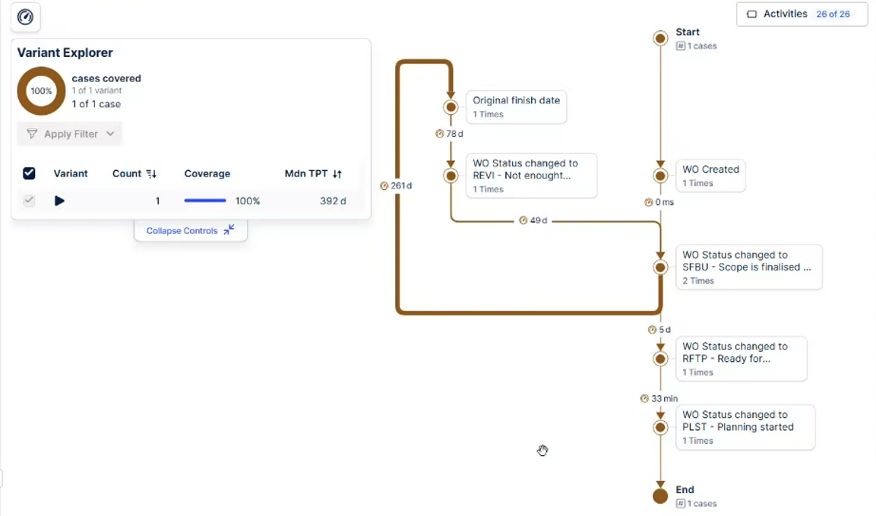
DIGITAL PROCESS TWINS
Mimicking real life processes
Combine different technologies: process mining, AI, IoT
Potential enabler for predictive control and optimization
Technical and organizational what‑if scenarios creation
Data fidelity, latency, governance are key to success

Slide 3
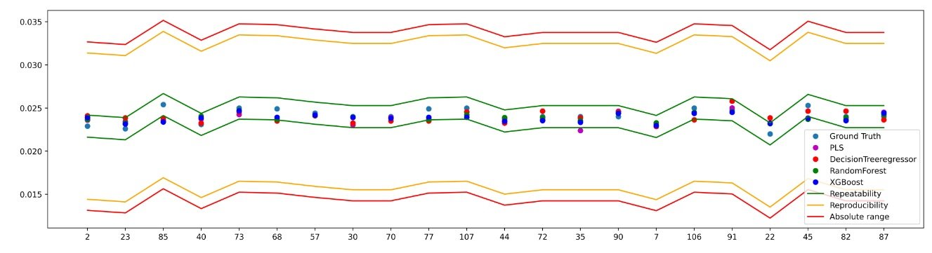
START WITH GOAL SETTING AND HONESTY
Start with curiosity about real processes
Define measurable end‑to‑end optimization goals
  Strategy aligned KPIs
  International benchmark
  Internal, external consultants’ advice
Align ambitions with cultural and architectural readiness
Optimalisation opportunity:
  Maintenance
  Logistics
  O2C
  Procurement
  Production
  Finance

Slide 4
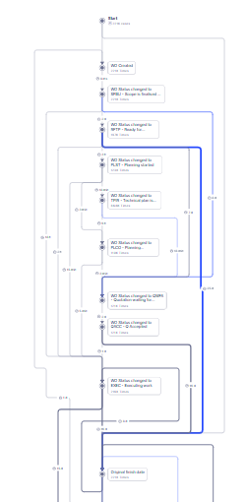
MEET WITH REALITY
Data contextualisation, quality and accessibility
Integration with legacy systems
Process descriptions – can AI help?
Number of process alternatives, loops
Compliance – Cybersecurity and Regulatory
Cultural acceptance

Slide 5


LET’S PLAN AND BUILD
Understand business opportunities and its operational consequences
Define goal and success measure KPIs
Define process steps and connect data sources
Discover APIs and ontologies
Ensure governed data to avoid digital illusion.
Review existing architecture’s event driven maturity
Plan small and integrate early—avoid isolated models
Involve operational SMEs early to fill knowledge gaps
Replicate source systems’ process flow
Use catalogue if it fits your business needs
Apply filters: status, cycle time, rework patterns

Slide 6

HARD PART OF DIGITAL PROCESS JOURNEY I.
Governance defines trust—the twin is only as reliable as its data lineage
Metadata management ensures process context and traceability
Continuous validation required as real processes evolve
Integrate governance with model lifecycle management
Align change management approaches, adoption model
Need for cross-functional alignment: BU, IT, OT, Operations

Slide 7
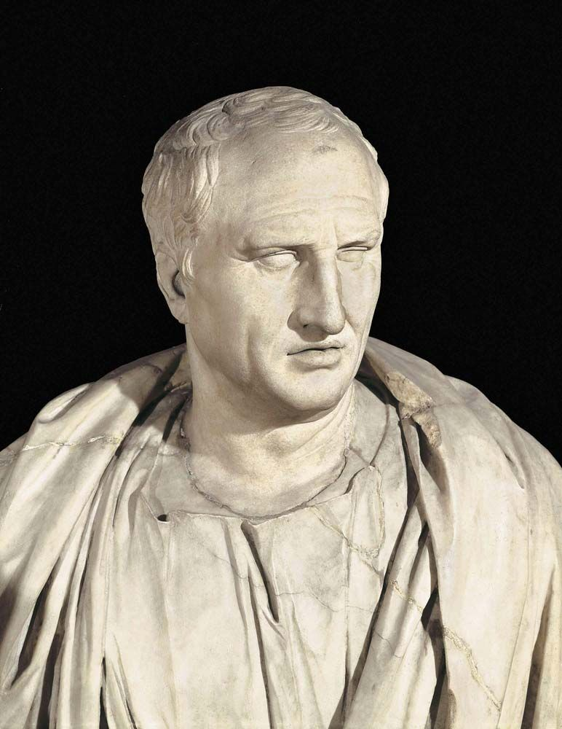
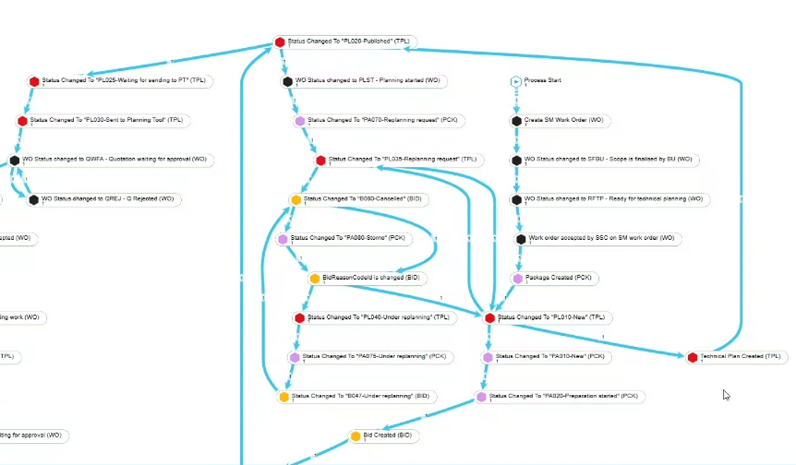
HARD PART OF DIGITAL PROCESS JOURNEY II.
How to handle multidimensional complexity and the huge amount of variation of a certain process
Cost benefit analysis, what to change what to keep
„Varietas dēlectat”
Source: https://www.britannica.com/biography/Cicero
Notes:
COMPLEX VARIATIONS
WHAT TO KEEP WHAT TO ELIMINATE AT WHICH COST AND BUTTERFLY EFFECT

Slide 8
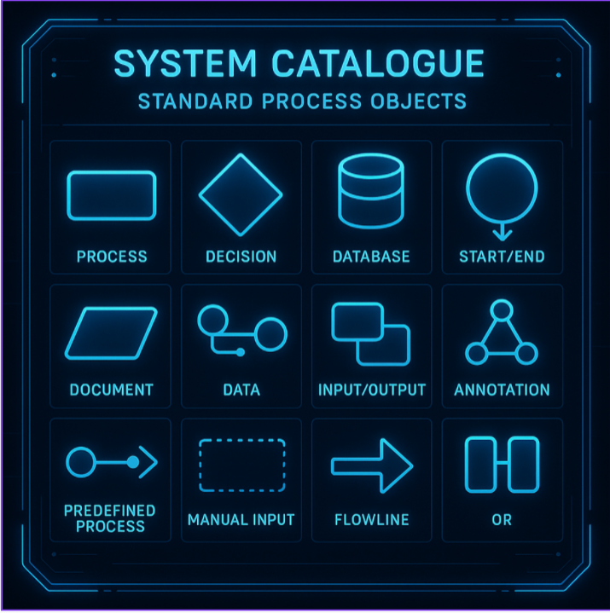
TAKE OFF THE SHELF SOLUTION AND PLUG&PLAY?
The hard way is the right way—complexity builds resilience and insight
As twins mature, focus shifts from mirroring to co-evolving processes
Potential future: autonomous twins collaborating across enterprise ecosystems
Start today: small, trustful, continuously adopt digital twins
.

Slide 9
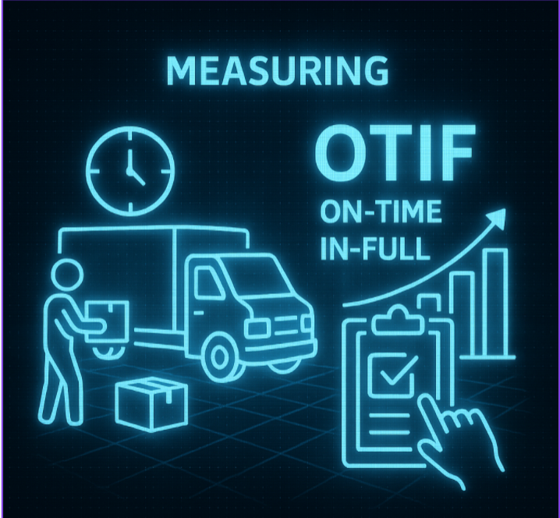
USE CASE I.

Slide 10
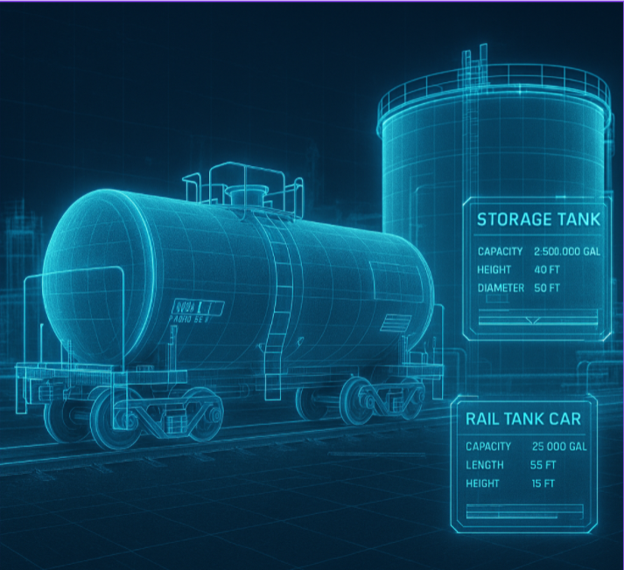
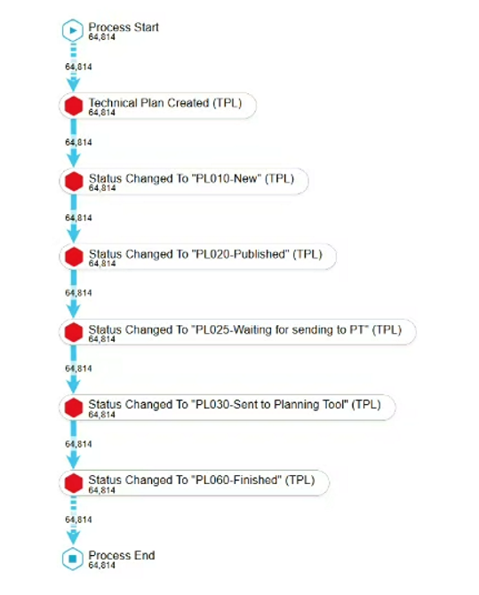
USE CASE II.

Slide 11
THANK YOU FOR YOUR ATTENTION

