Slide 1


How To Drive Agentic AI In Large Enterprises
Utku Pazar

Slide 2


Utku Pazar
Ex – Chief Digital and Strategy Officer at Beko
Ex – McKinsey
Ex – Nokia
IDC Global Advisor
CEMS Advisory Board Member
WEF AI Transformation of Industries Member

Slide 3


Slide 4




Agentic AI is rewriting the rules
AI Momentum
The Value Problem⁽¹⁾
Billion/Trillion $ Question
Trillion Dollar
Investments
Trillion Dollar
Companies
No material contribution to P&L
With Mature Gen AI Strategy
How to become an
Agentic Enterprise and create value ?
80%
1%
1. Mckinsey, Seizing the agentic AI advantage, 2025

Slide 5

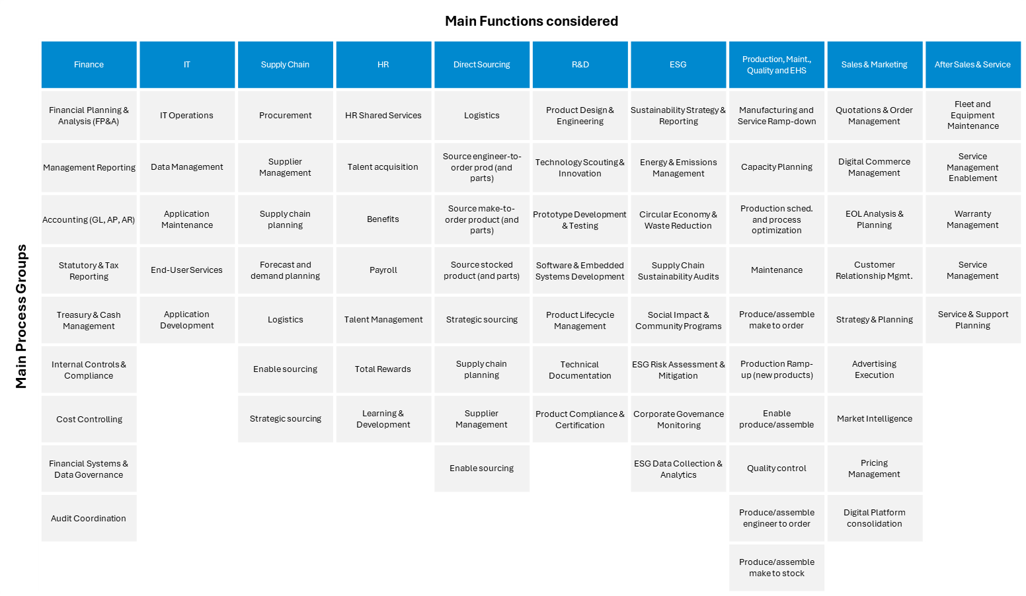
Becoming an agentic enterprise for organizations
Option 1: Bottom Up Approach
Approach
Workshops to identify use cases
Prioritization and budgeting
Piloting
Rollouts (Countries, functions)
1000+ Processes
10+ domains
45K potential agents
Region/
Country

Slide 6
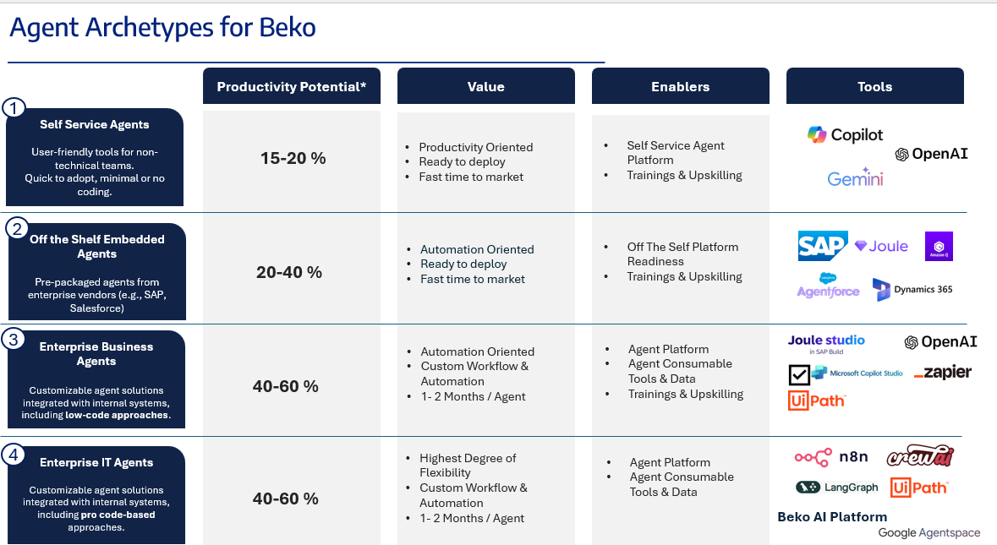
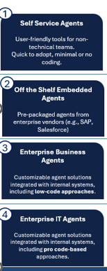
Becoming an agentic enterprise for organizations
Option #2: Top Down Approach
Shift from scattered use-cases to holistic transformation
Piggyback on Managed Services 🡪 (existing managed-service infrastructure for scale)
Shared Service Center Transformation 🡪 (Move from manual SSCs → autonomous, agent-driven service hubs)

Slide 7

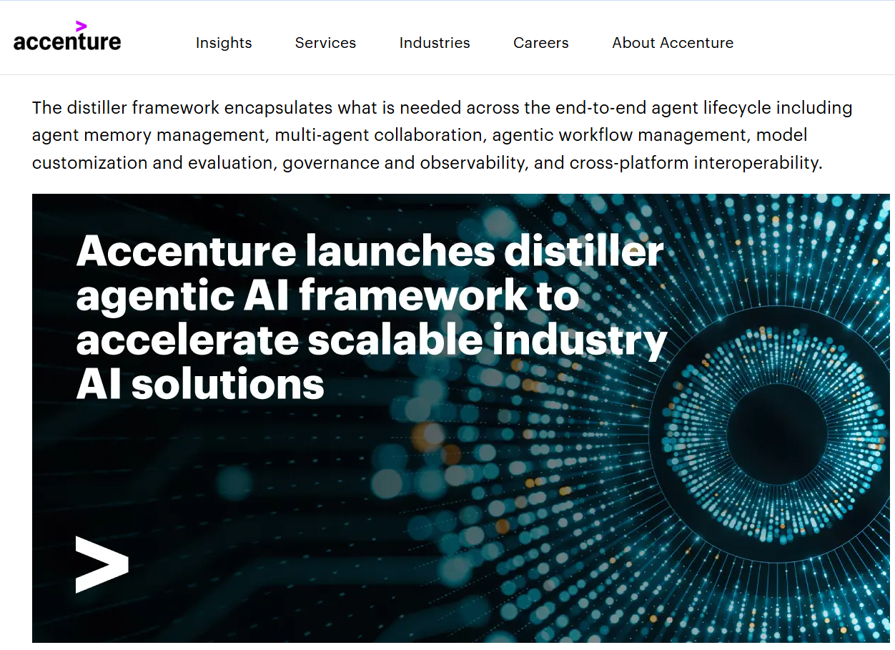
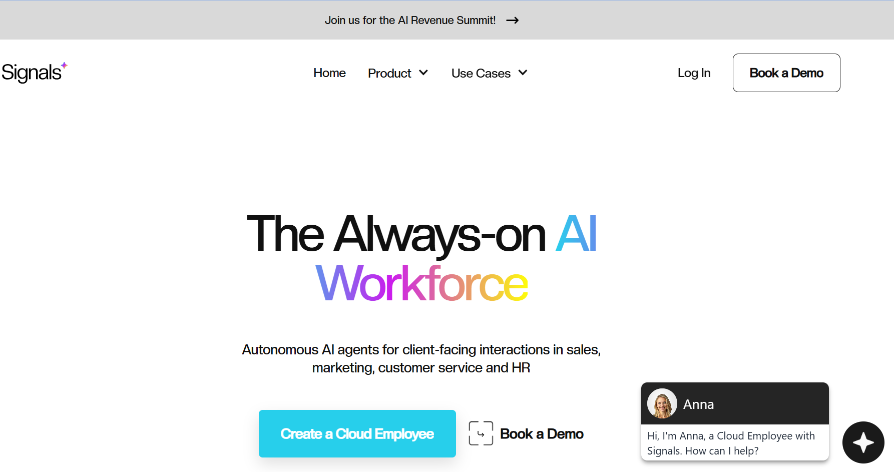
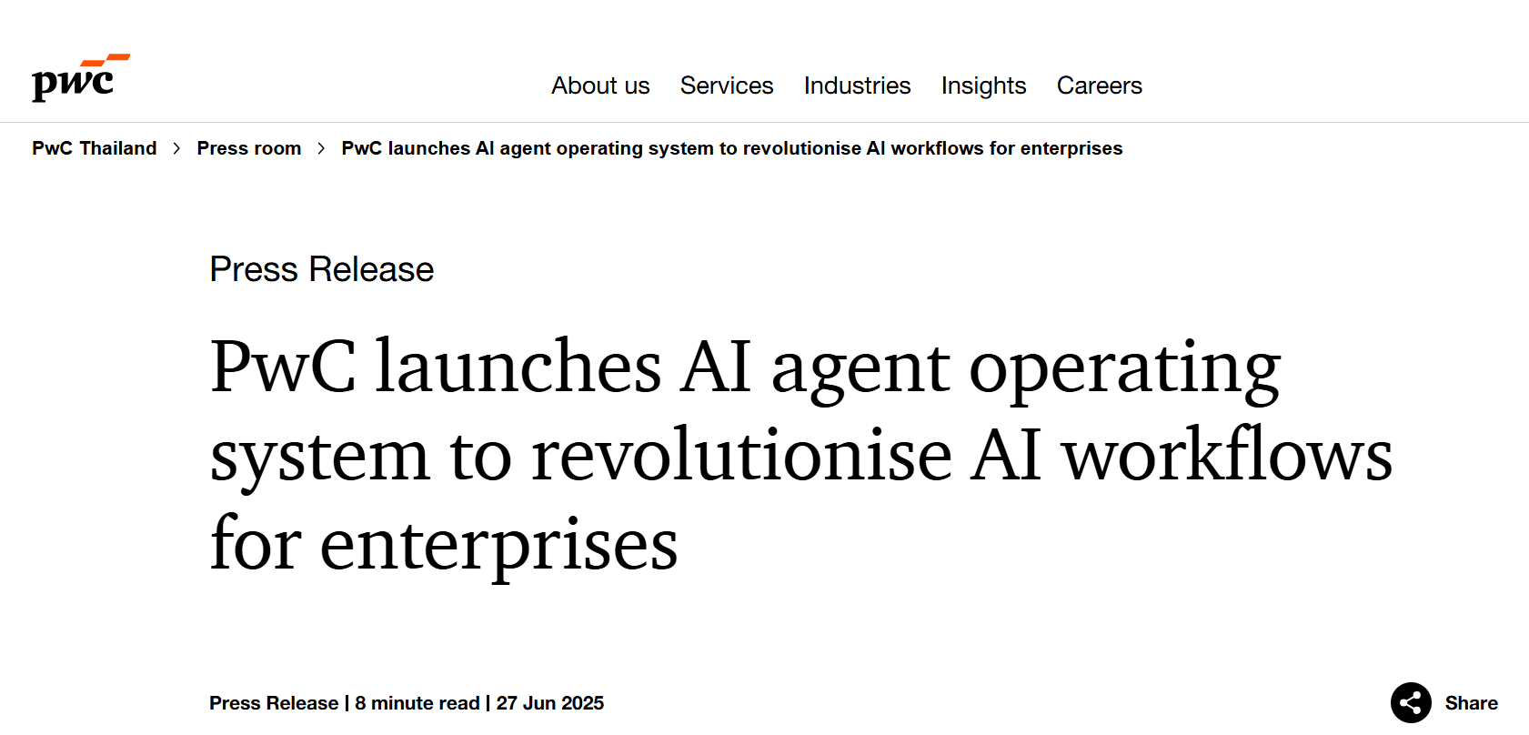
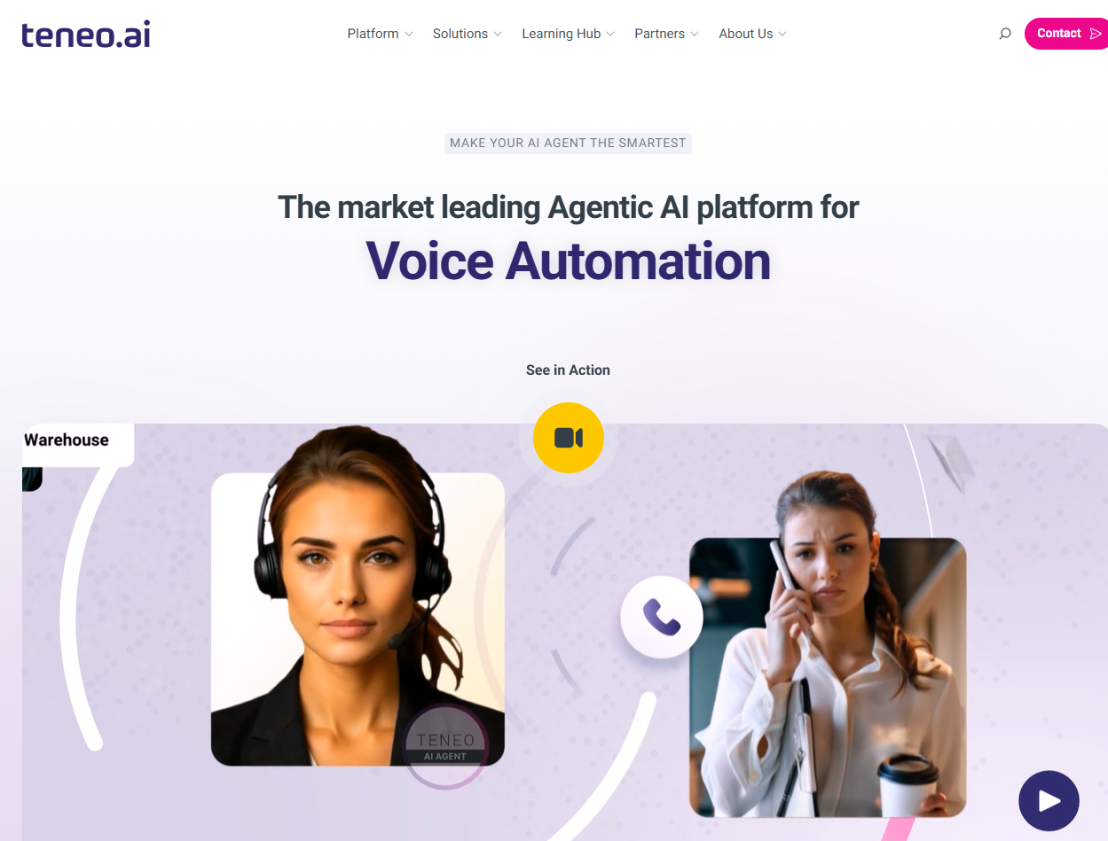
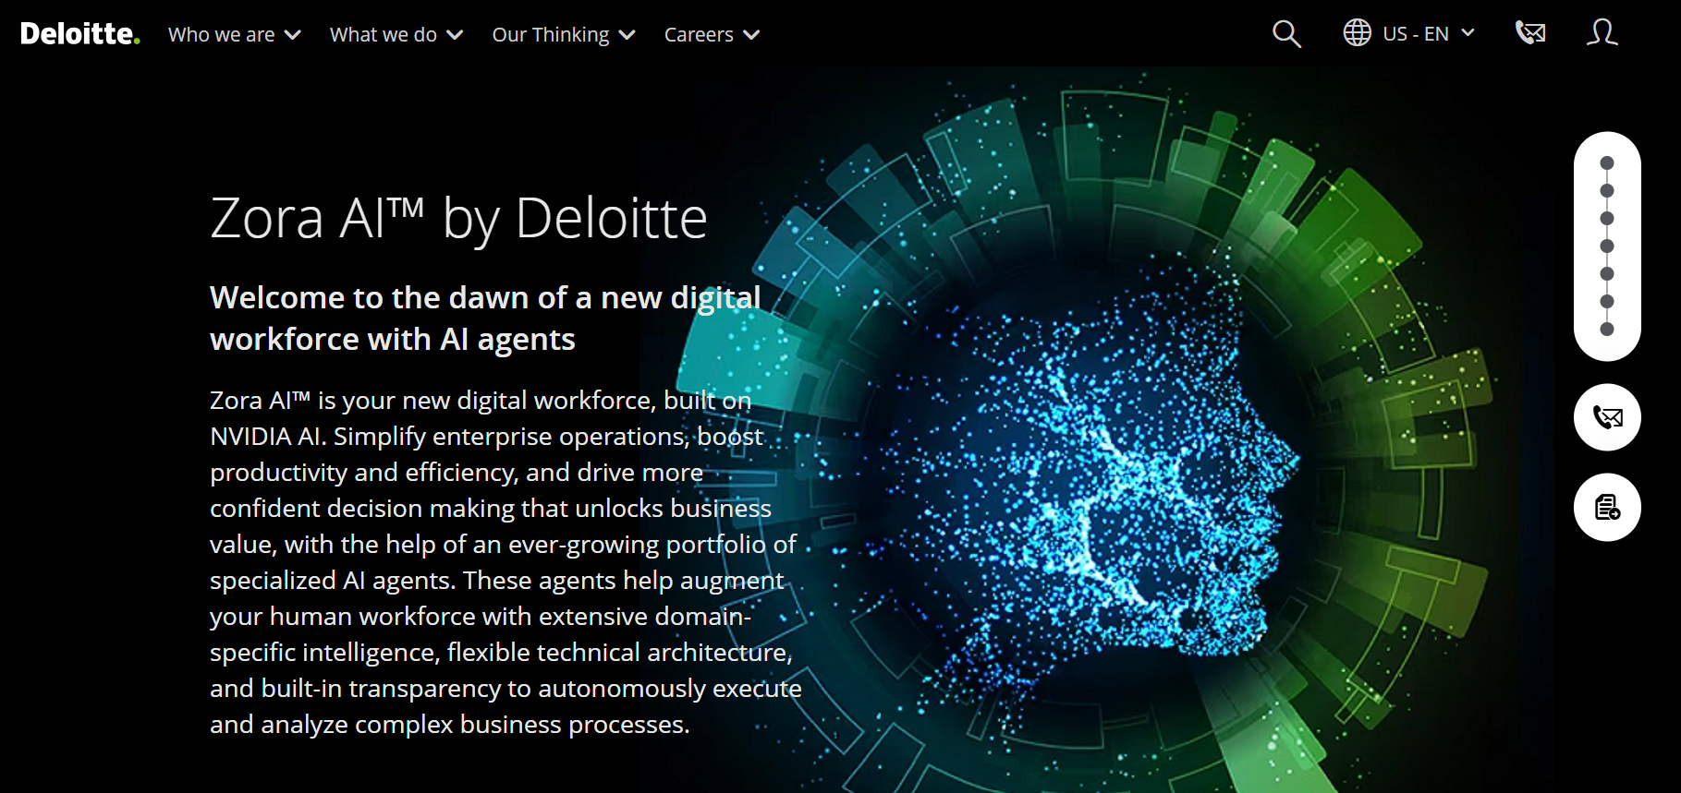
Alternative Approaches: Consulting,Managed Services Firms and newcomers try to address this enterprise challenge
Accenture
Signals
PwC
Deloitte
Teneo.ai
Industry- Tailored Agentic Solutions
Built-in, existing manage services infrastructure

Slide 8

Blueprint for an AI-Native Enterprise
Structures
AI Center of Excellence – A Central Team that really knows Agentic AI
“Global” Data Governance: Establish or strengthen
Ready the enablers - Scalable & modular infrastructure | APIs
Processes
Top Down > Bottom Up
  Bottom up experimentation with MVPs (Tool Trials) & Top down bold initiatives
  Create C-Suite Ownership for top down initiatives
Focus – Pick 1 well defined problem and fix it
Culture
Model learning behaviors - IT to lead the way, walk the talk in IT
Hiring & promotion tied to AI Outputs
Reward Curiosity Hackathons
Embrace Partnerships – No one can succeed alone
People
Upskill & Reskill key talent – 1 Expert > 100 “I learned how Gen AI works”
Democratize AI access – Seminars, Tool Labs
Exec. Leadership AI Literacy – Most execs don’t get it

Slide 9
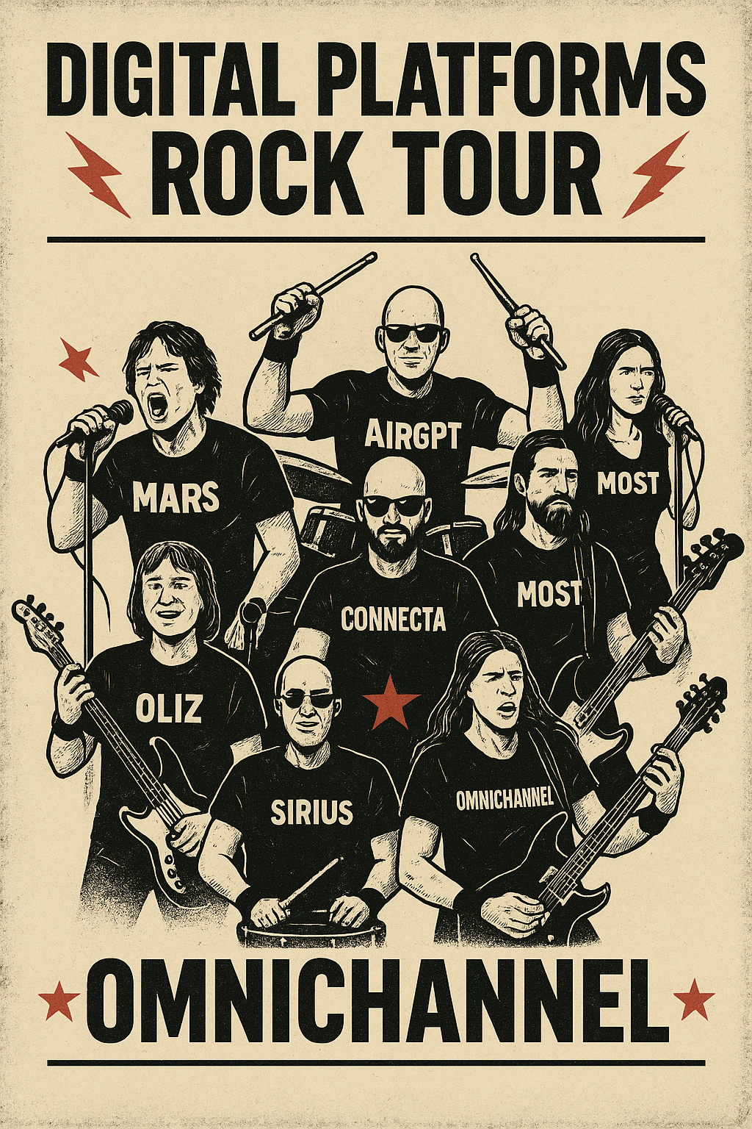
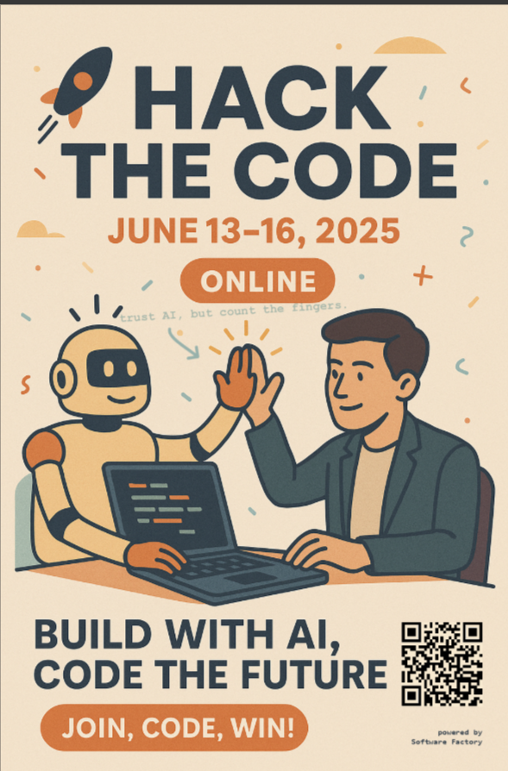
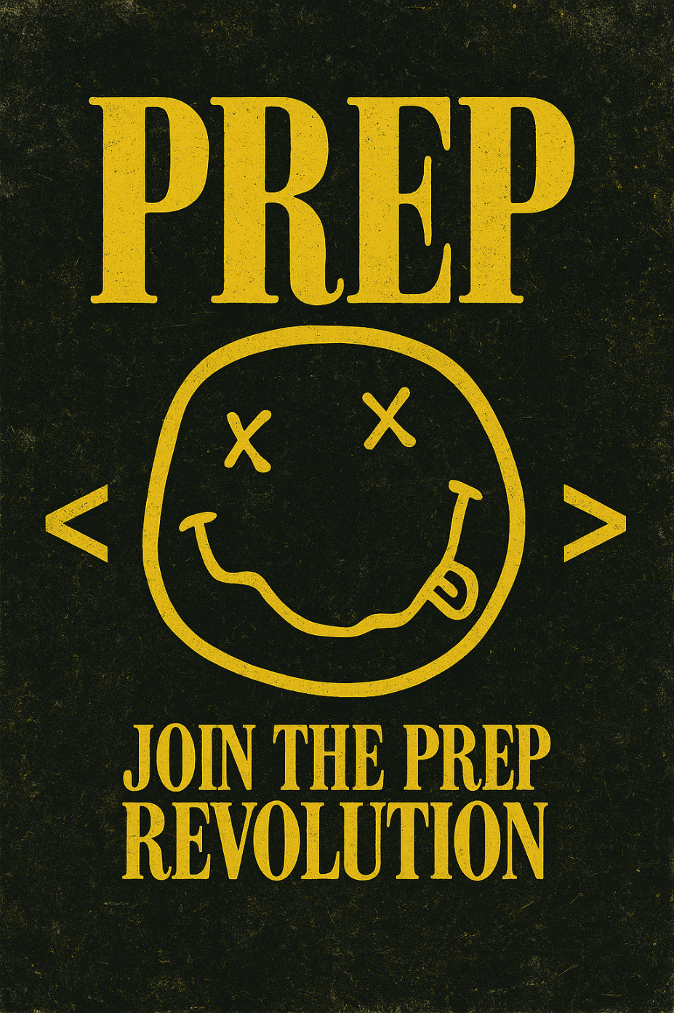

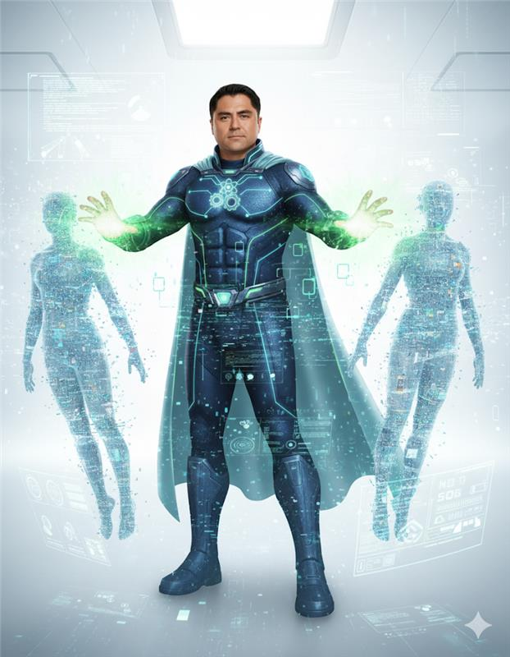
Last Tip: Create your own micro-culture with your AI team

Slide 10


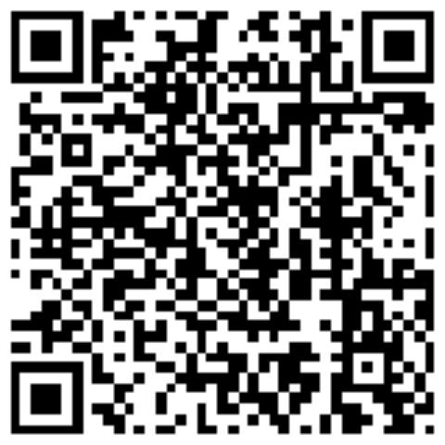
Thank You
Utku.Pazar@gmail.com
https://www.linkedin.com/in/utkupazar/

